Slide 1

PROJECT BIG DATA TECHNOLOGY
Twitter Data Streaming and Analysis
BY: BINIAM AREFAINE ID:110972
EYOB WELDEYOHANNES ID:110931
YOHANNES MULUALEM ID: 110930
PROF Mrudula Mukadam

Slide 2
Contents
Introduction
Tools
Apache Kafka
Spark Streaming
Spark SQL
Visualization

Slide 3
Introduction
The General aim of the project
Create an end to end pipeline that will consume live tweets from twitter API and save it temporarily or permanently on hdfs and to visualize it using visualization tools.
Demonstrate to analyze the data's by firing up some queries and visualizing them in Tableau
Tweeter's Streaming API
Tweeter’s Streaming API is a push of data as tweets happen in near real-time. With Twitter’s Stream API, users register a set of criteria(Keyword, usernames, location, named, places, etc.)

Slide 4
Tools used in our project
Twitter API (source)
Kafka (stream-processing)
Scala-IDE
Spark streaming
Parquet files
Spark SQL
HIVE
Tableau

Slide 5
Setting up the VM environment
Download and Install Kafka
Download kafka application from https://kafka.apache.org/downloads and un-zip it
Open the command line and run “gedit ~/.bashrc” , a bash file will open and paste the path of the unzipped, in our case it is, “export KAFKA_HOME=/home/cloudera/Desktop/kafka_2.13-2.6.0
export PATH=$PATH:$KAFKA_HOME/bin”
Zookeeper should run first, and assuming the zookeeper is running perfectly then start the kafka by typing the command line “cd $KAFKA_HOME” and then “kafka-server-start.sh ./config/server.properties” …… now kafka is running perfectly
Download scala IDE and install scala
Download scala IDE for linux at https://www.scala-lang.org/download/ and select the appropriate version.

Slide 6
Apache Kafka
Apache Kafka is an open source stream-processing software platform developed by the Apache software foundation, written in Scala and Java. Kafka aims to provide a unified, high-throughput, low-latency platform for handling real-time data feeds.
Website Activity Tracking . This means site activity (page views, searches, or other actions users may take) is published to central topics with one topic per activity type.
Social media. facebook, twitter, etc….
Positional Data. Delivery trucks or massively multiplayer online games can send location data to a central platform.
Event Source: is a style of application design where state changes are logged as a time-ordered sequence of records. Kafka's support for very large stored log data makes it an excellent backend for an application built in this style.

Slide 7
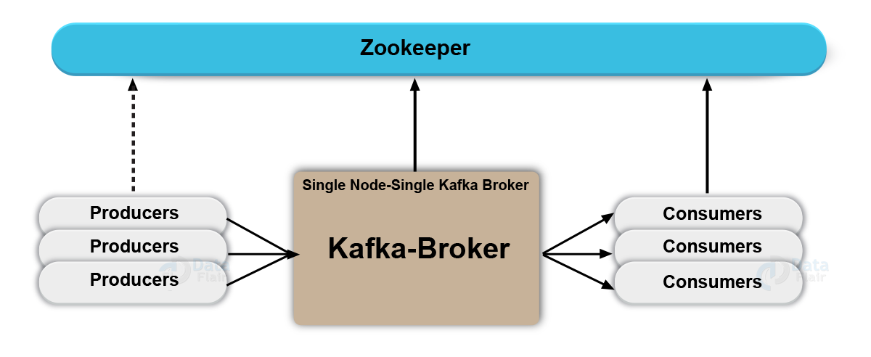
Apache Kafka ctnd…
Kafka broker
A Kafka cluster consists of one or more servers (Kafka brokers) running Kafka. Producers are processes that push records into Kafka topics within the broker. A consumer pulls records off a Kafka topic.

Slide 8
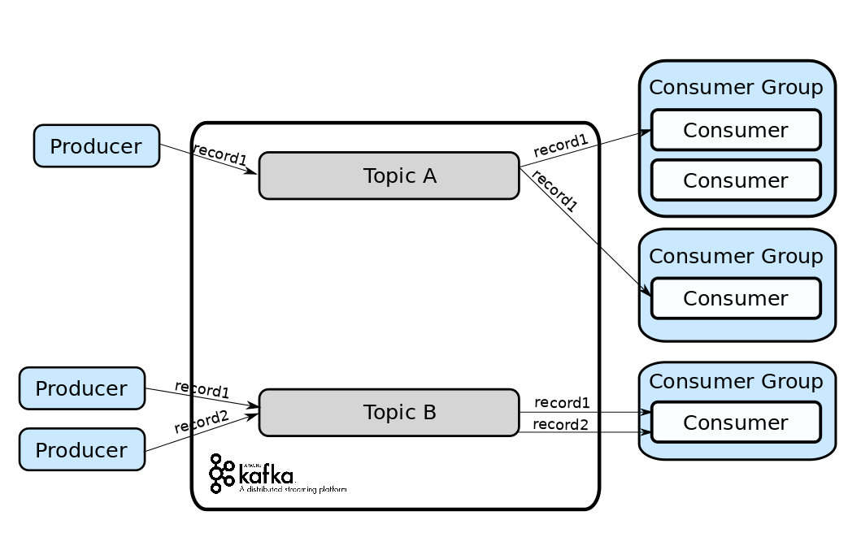
Apache Kafka ctnd…
Kafka topic
A Topic is a category/feed name to which records are stored and published.

Slide 9

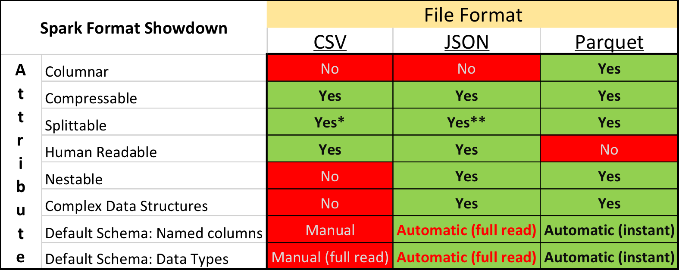
Parquet file format
Parquet is an open source file format available to any project in the Hadoop ecosystem. Apache Parquet is designed for efficient as well as performant flat columnar storage format of data compared to row-based files like CSV or TSV files.

Slide 10
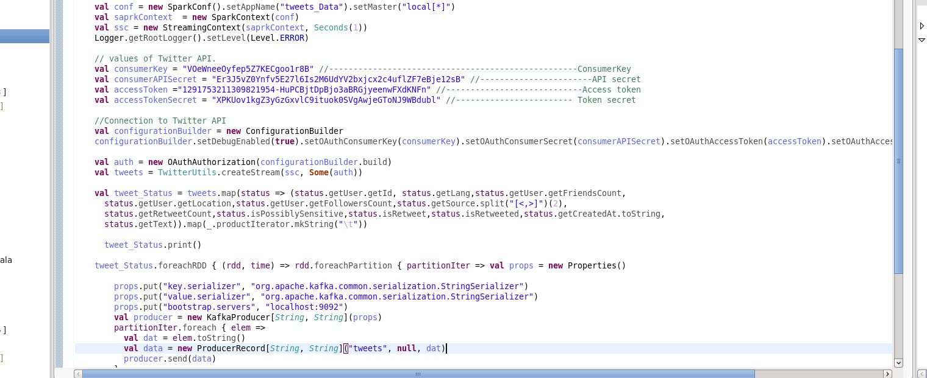
Sample code for the producer

Slide 11
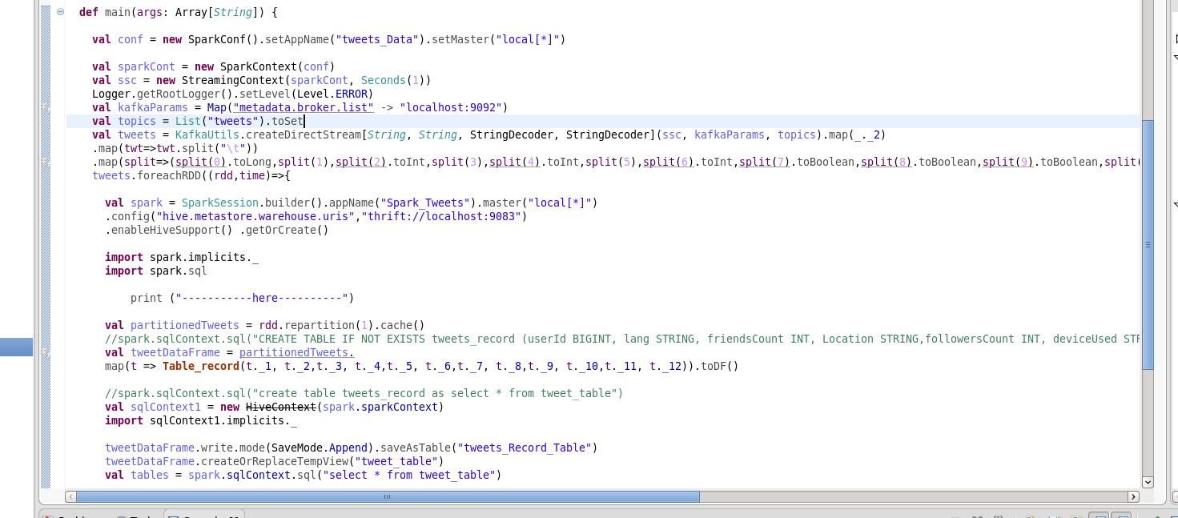
Sample code for the consumer

Slide 12

End-to-End Data Streaming Pipeline

Slide 13
Spark SQL
Introduction:-
Spark SQL is a Spark module for structured data processing
It provides a programming abstraction called Data Frame and can act as distributed SQL query engine.

Slide 14
Features of Spark SQL
Integrity:- mix SQL with spark programs
Unified Data Access − Load and query data from a variety of sources
Hive Compatibility
Standard Connectivity :- can connect by JDBC, ODBC
Scalability

Slide 15
Spark SQL Advantage
Spark SQL will allow developers to
Import relational data from Parquet files and Hive tables
Run SQL queries over imported data and existing RDDs
Easily write RDDs out to Hive tables or Parquet files

Slide 16
Spark SQL Advantage over HQL
Row-level updates and real-time OLTP querying is not possible using Apache Hive whereas row-level updates and real-time online transaction processing is possible using Spark SQL
Spark SQL is fast

Slide 17
Spark SQL Implementation
Spark SQL can support many queries(simple select, join, aggregate, limit, UDF etc..).
We can run it in command or in eclipse.

Slide 18
How to run Spark SQL in command
In command we don’t need to create spark context and spark Session.

Slide 19
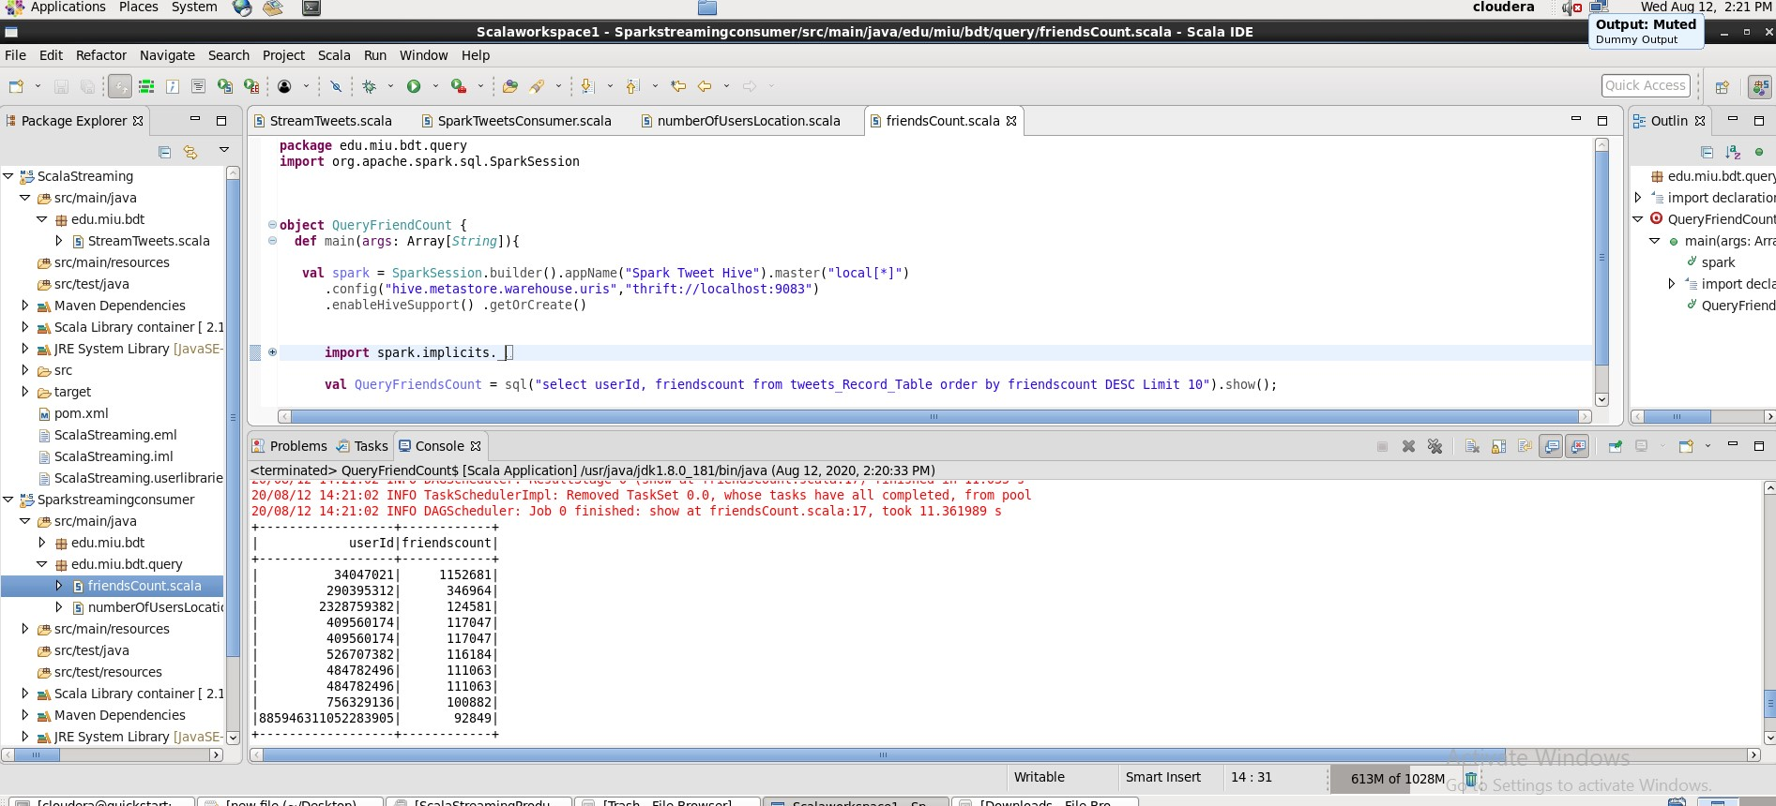
How To Run Spark SQL In Eclipse
We can use Scala, java or python language, but here is in Scala

Slide 20
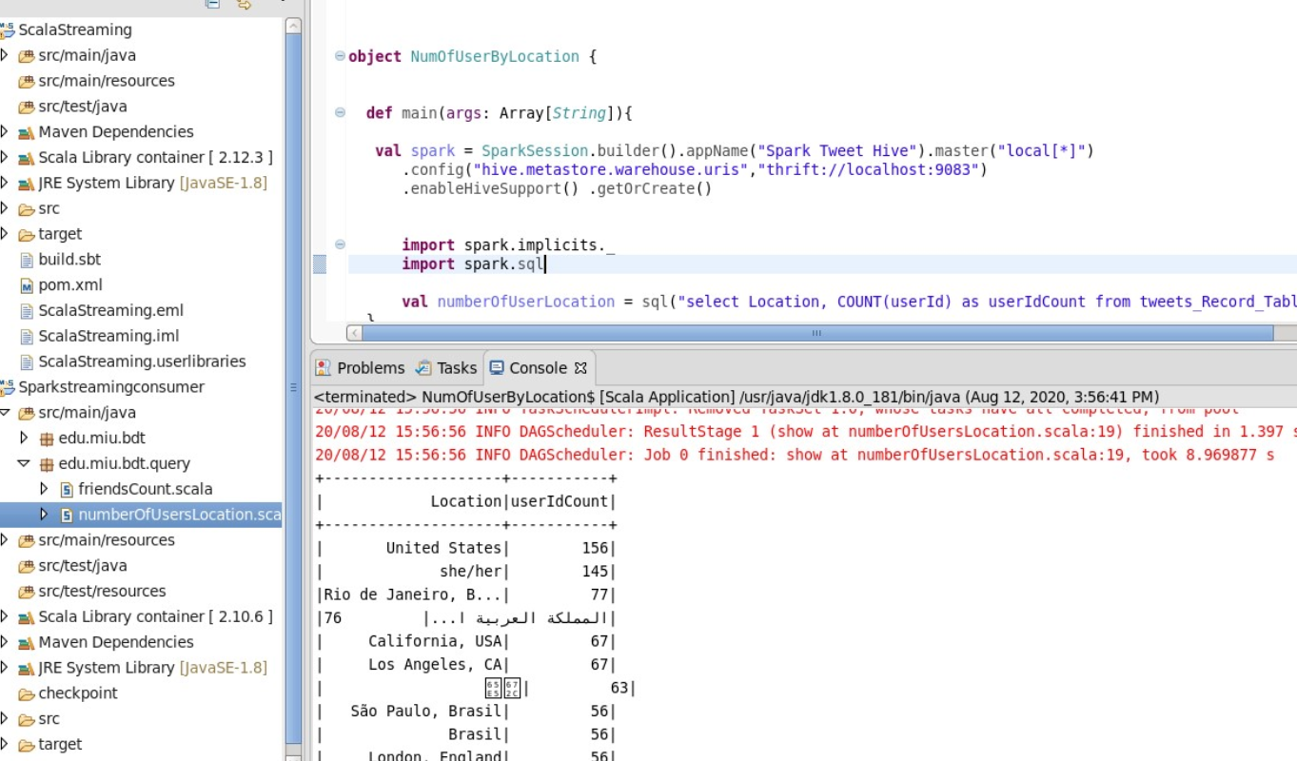
Eclipse Spark SQL cont’d
To find number of users by location

Slide 21

DATA VISUALIZATION
Data visualization is the graphical representation of information and data. By using visual elements like charts, graphs, and maps, data visualization tools provide an accessible way to see and understand trends, outliers, and patterns in data.

Slide 22
Tableau
Tableau Desktop is a business intelligence and data visualization tool that can be used by anyone. It specializes in transforming boring tabulated data into eye-candy graphs and representations. With tableau desktop, you can enjoy real-time data analytics by directly connecting to data from your data warehouse.
We can easily download tableau desktop and connect with our cloudera Hadoop (Hive).
Link Tableau download

Slide 23
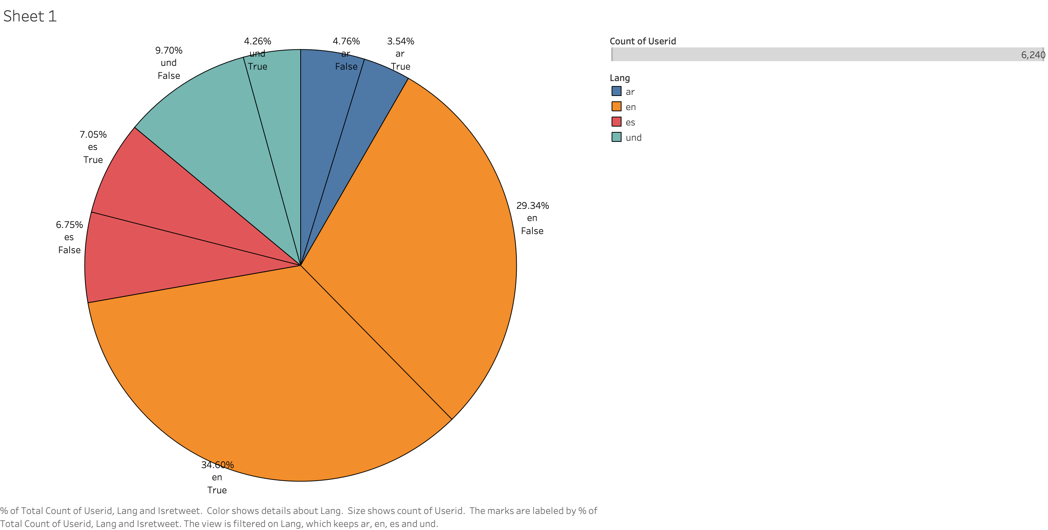
Total Count of Userid ,Language and Isretweet

Slide 24
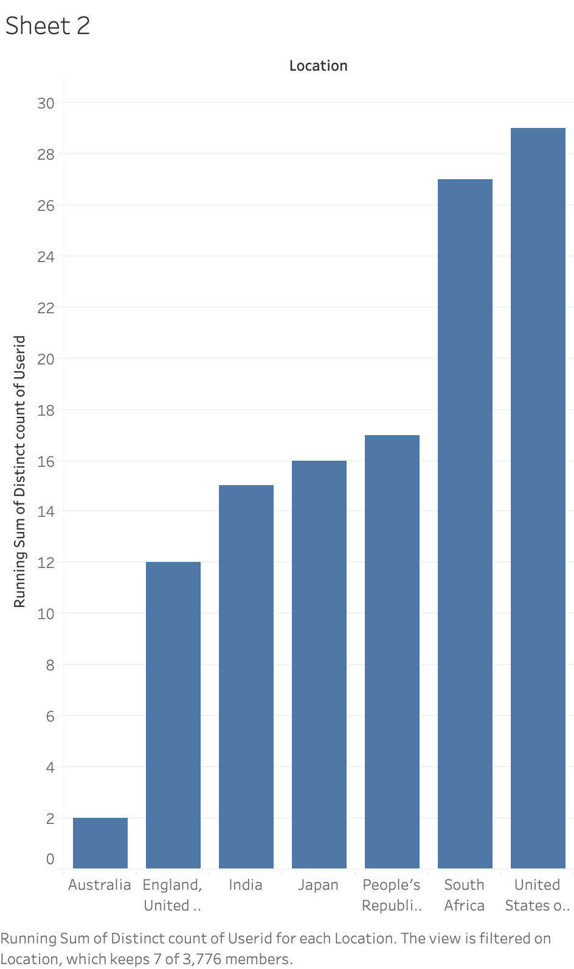
Sum of Distinct count of Userid for each Location

Slide 25


